Slide 1
Introduction to JavaScript, Json, TypeScript, TSX
Cours Esilv 2024
arnaud.nauwynck@gmail.com

Slide 2
Outline
JavaScript
JSON
TypeScript
TSX

Slide 3
JavaScript
Java Script
Syntax inspired from "Java"
(itself inspired from "C", "C++")
untyped at compile-time,
interpreted at runtime
like "script" shells.
only "string", "numeric", boolean".
no "class" or type declarations !

Slide 4

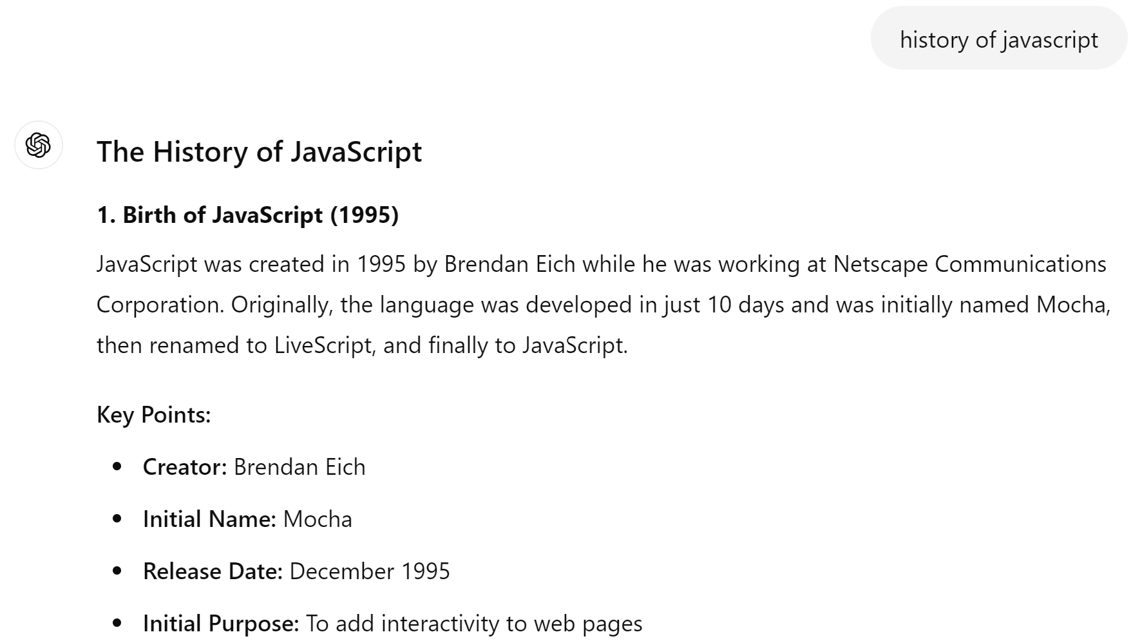
Birth of JavaScript : 1995

Slide 5
JavaScript Evolution
1995
1997
2005
2009
2012
2015
Adopted by browsers, but not standard
submitted to ECMA international
for standardisation
spec : "ECMAScript"
AJAX and Web 2.0
standardisation of browsers
ECMAScript 5
strict mode, JSON, ...
birth of many frameworks
(jQuery, AngularJS, etc..)
birth of Node.JS
server-side JS
development ecosystem (npm, grunt, gulp, ..)
ECMAScript 6 (=2015)
class, arrow, modules, ...
Birth of JS
used in
Netscape
web browser
TypeScript

Slide 6
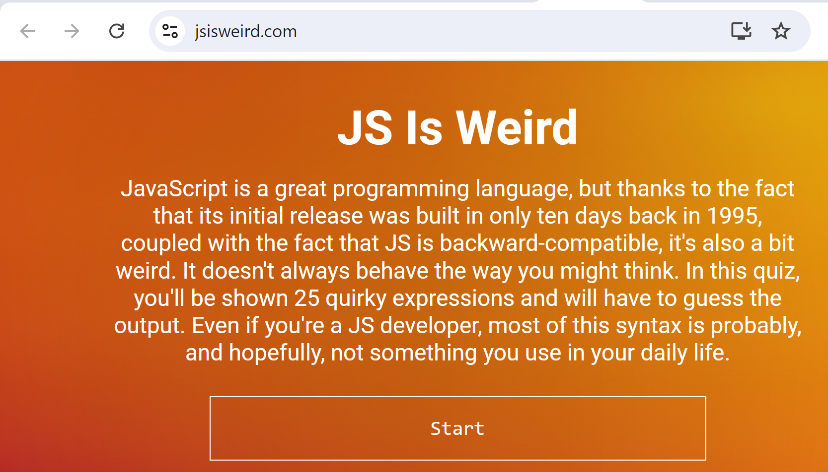
developed in 10 days by 1 person ... => explain many weird parts of the langage
https://jsisweird.com/

Slide 7
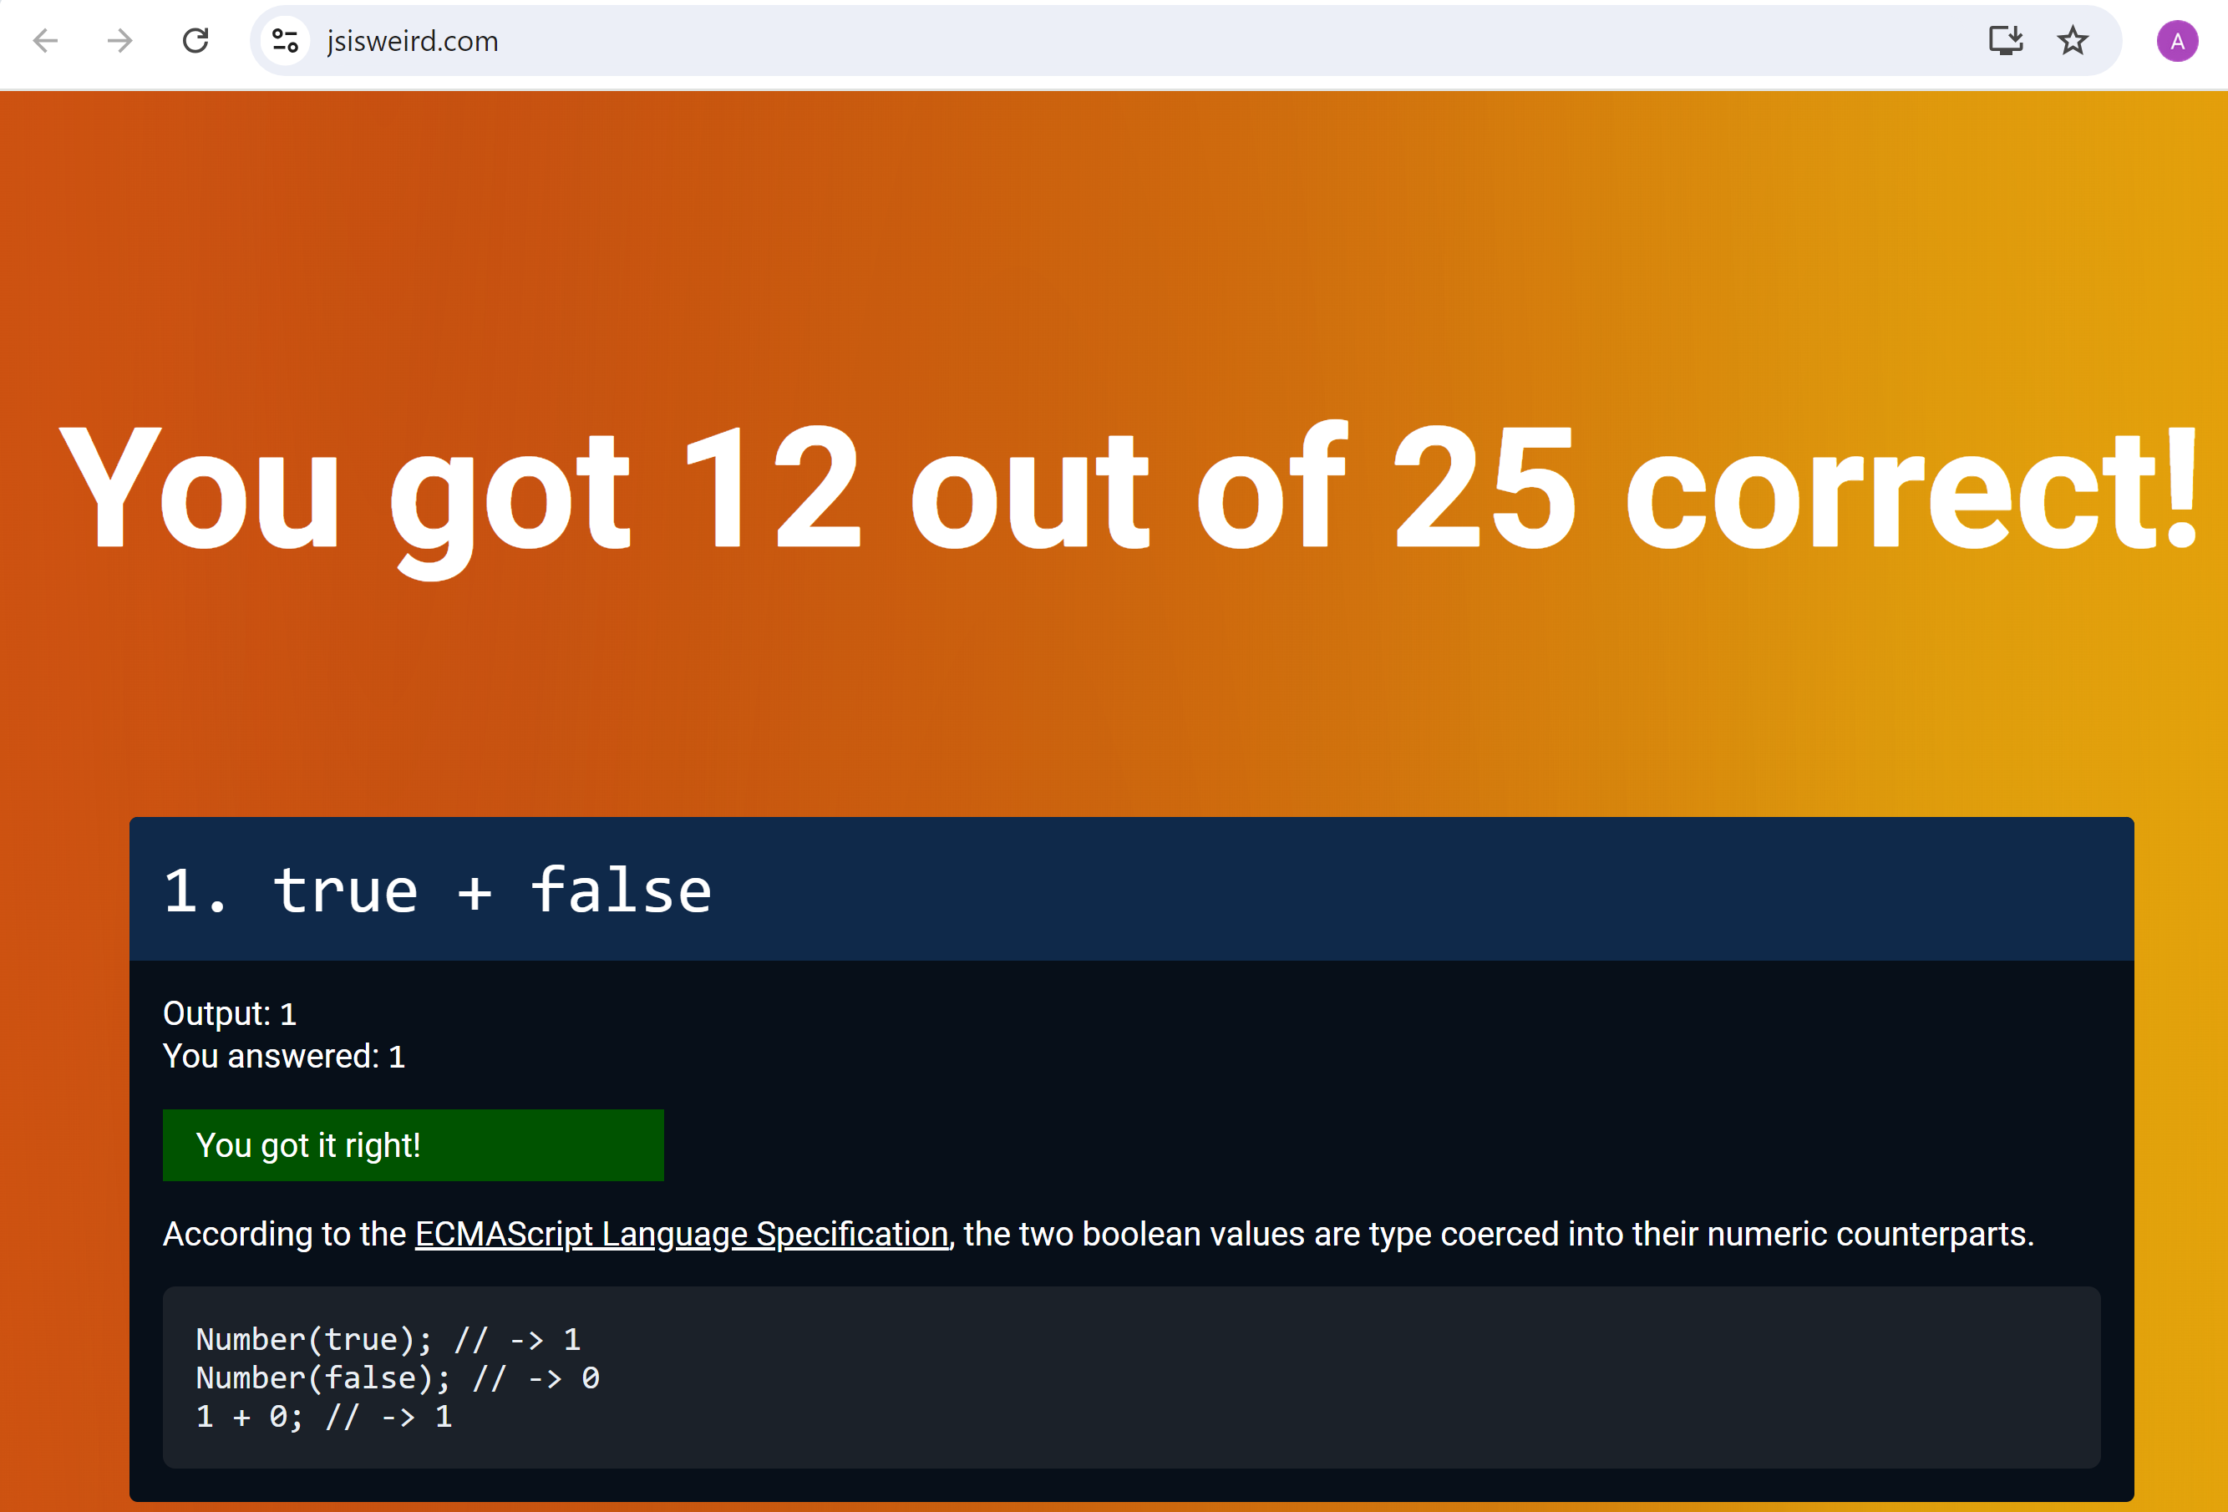
even for me
There are (strange) implicit coercions between primitive types...
For exact comparison, use "===" ( "==" may introduce conversions )

Slide 8
JavaScript = un-maintanable code !!
NO Type !! .. alternative like Google Dart since 2011 (ex in Flutter)
.. work-around since 2012 via TypeScript NO Class ! .. work-around since 2012 via TypeScript .. ok since 2015 EcmaScript6

Slide 9
Runtime Implementations
1998
2008
2009
2013
2020
Netscape
Firefox
Chrome (=v8)
Opera (=v8)
Edge (=v8)
Node.JS (=v8)
Mozilla
Open-Source
organisation
created from
Netscape Company
Firefox from
Nescape Navigator
Internet Explorer
Node.JS re-use the same runtime
as Chrome : "V8"
IE had is own runtime.
his own non-standard specs
=> lot of behavior differences
jQuery was a hack for compatibility
many browsers followed
(Opera in 2013, Edge in 2020, ...)

Slide 10
JavaScript Primitive Value Objects
null
undefined
String
Numeric
Boolean

Slide 11
Object Compositions: [Array], {Object}
Array
Object

Slide 12
JSON = JavaScript Object Notation
NO code, only Value
Can be integrated directly in JavaScript (or TypeScript)
=> SUPER Easy for Http Rest using JSON as data encoding protocol
in pure JSON, identifier need to have double-quotes
... NOT needed in Js/Ts

Slide 13
JSON Example
{
"a": null,
"b": undefined,
"c": 123,
"d": true,
"e": "text with escaped \" and \n chars",
"f": [ null, undefined, 123, true, [], {} ],
"g": { "subField": 1, "b": true }
}

Slide 14
Example Unquoted JSON directly in JavaScript
let obj = {
a: null,
b: undefined,
c: 123,
d: true,
e: "text with escaped \" and \n chars",
f: [ null, undefined, 123, true, [], {} ],
g: { subField: 1, b: true }
};

Slide 15
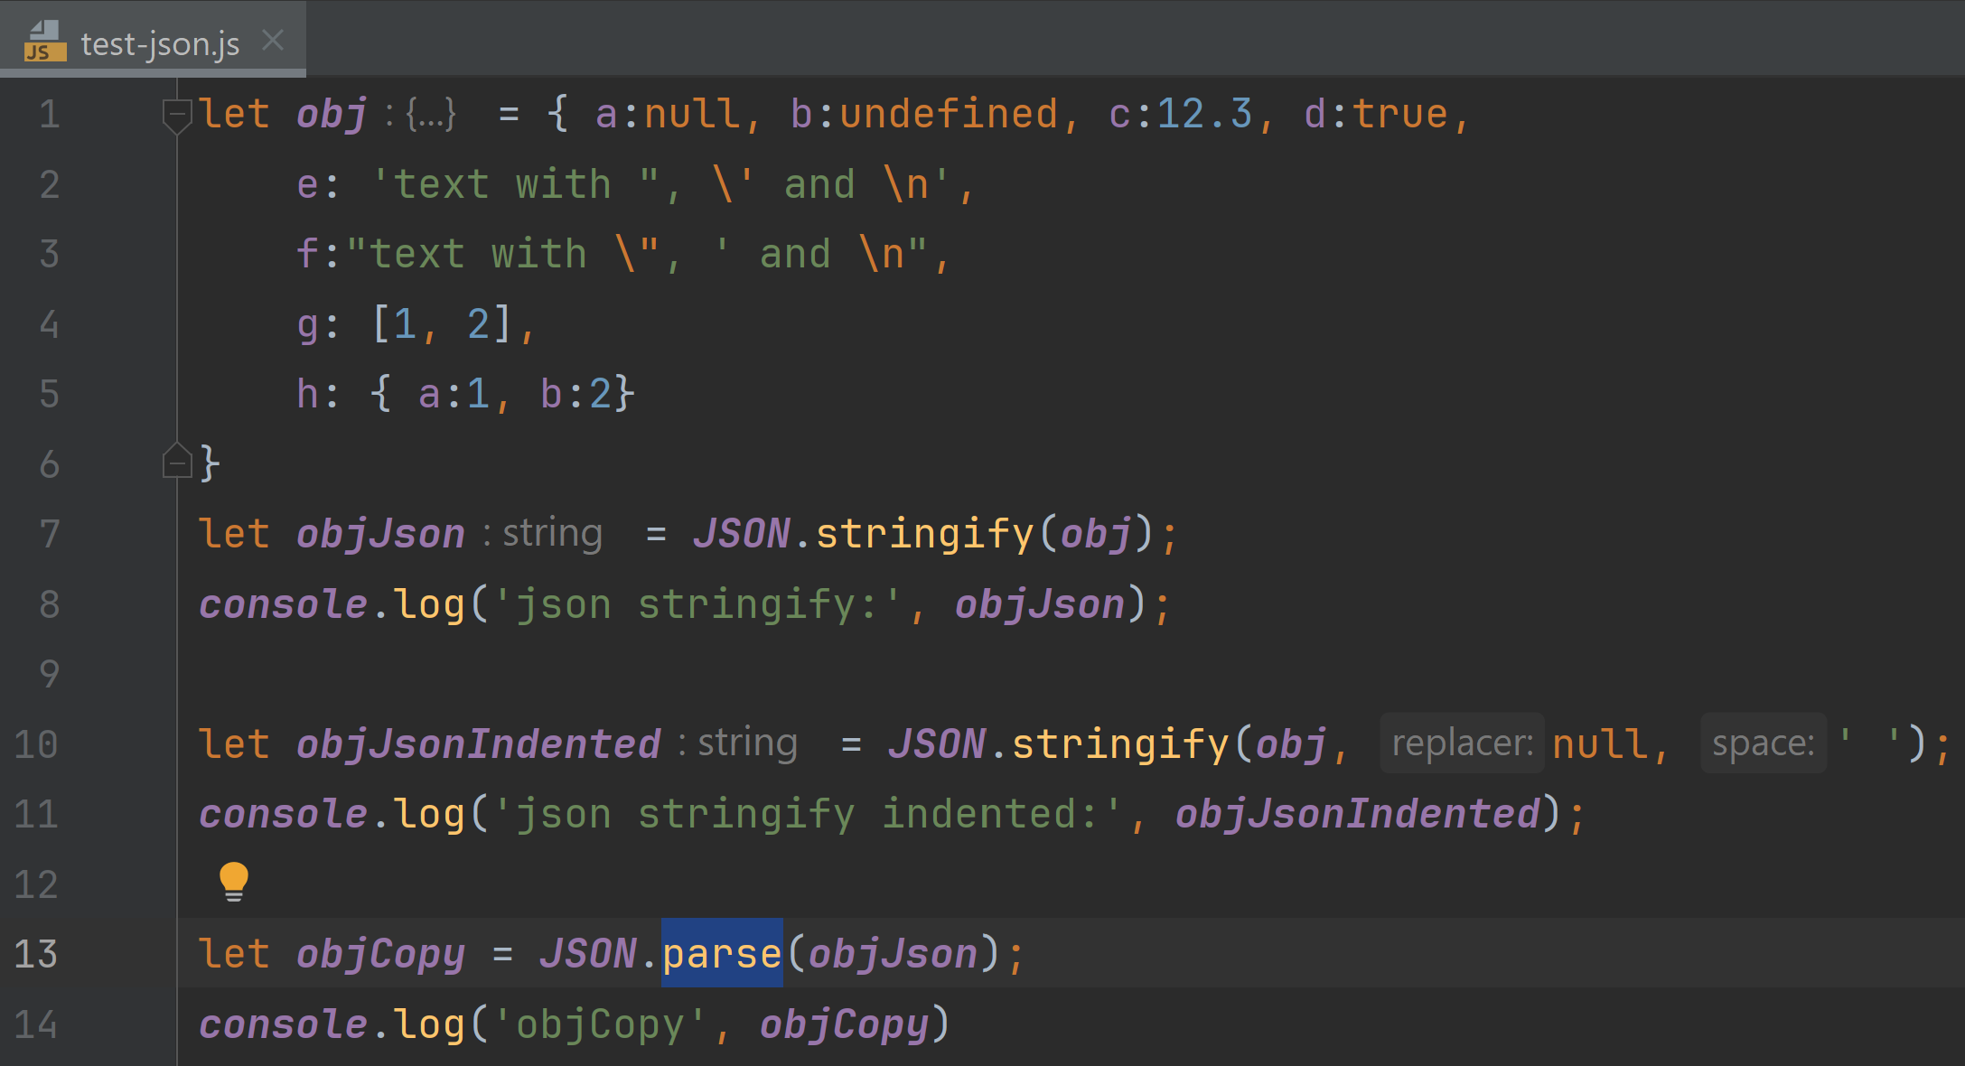
JSON stringify() / parse()... builtin in JavaScript

Slide 16
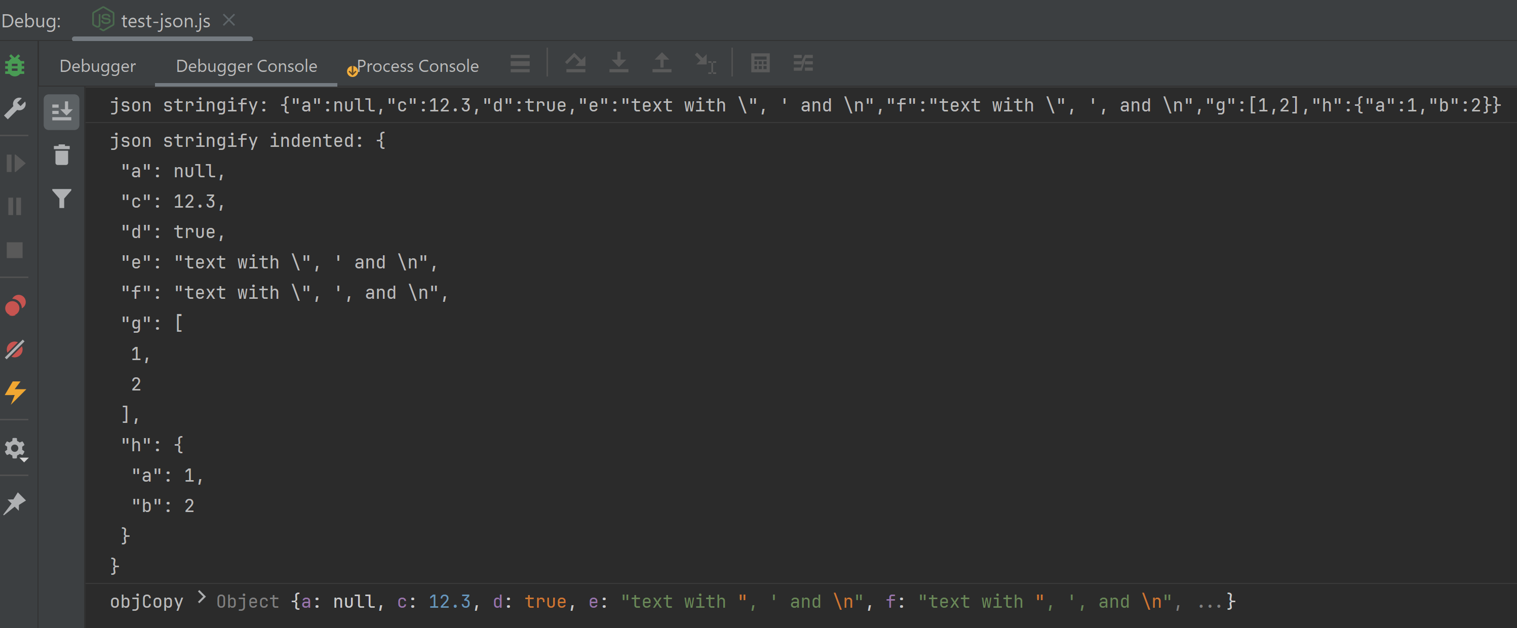
stringify, parse

Slide 17
JavaScript object deep clone

Slide 18
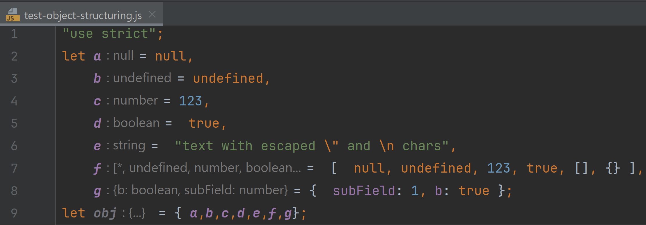
Object Creation from variables without reapeating "a":a, "b":b, simply {a,b}

Slide 19
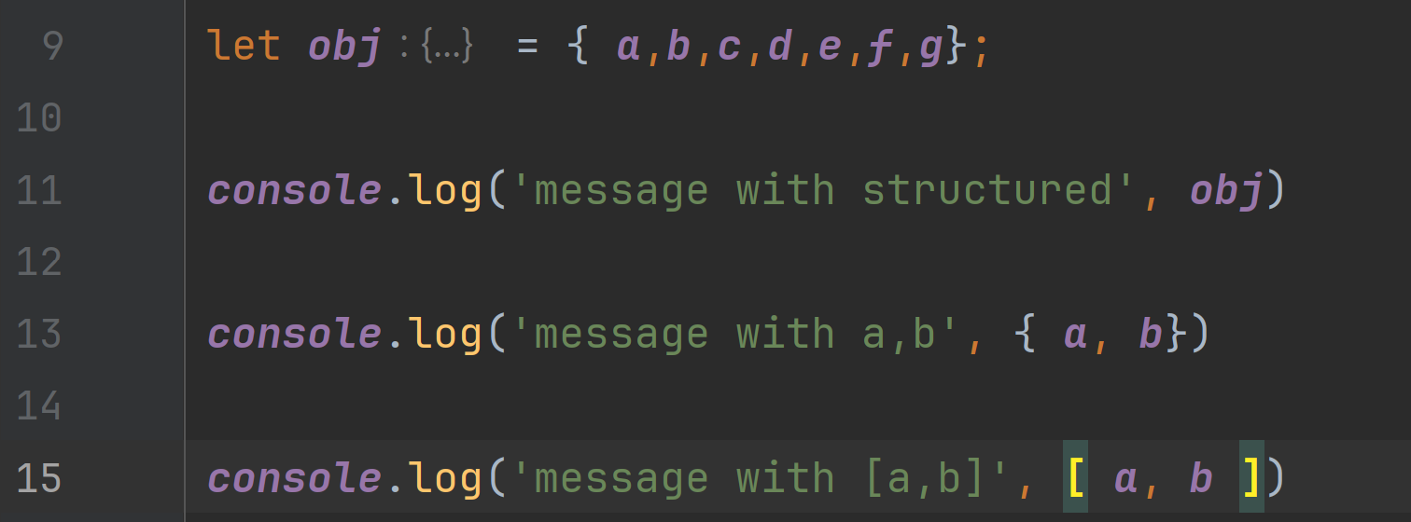
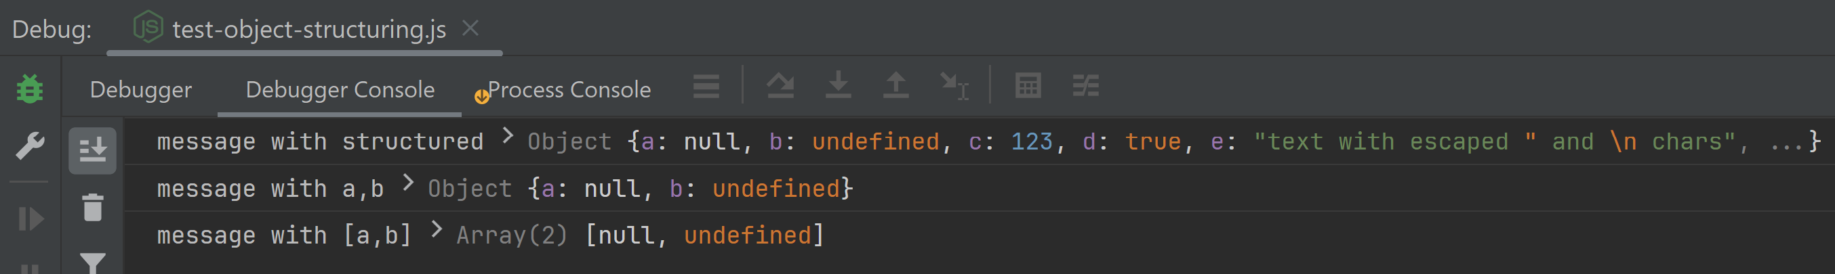
Structured Logging

Slide 20
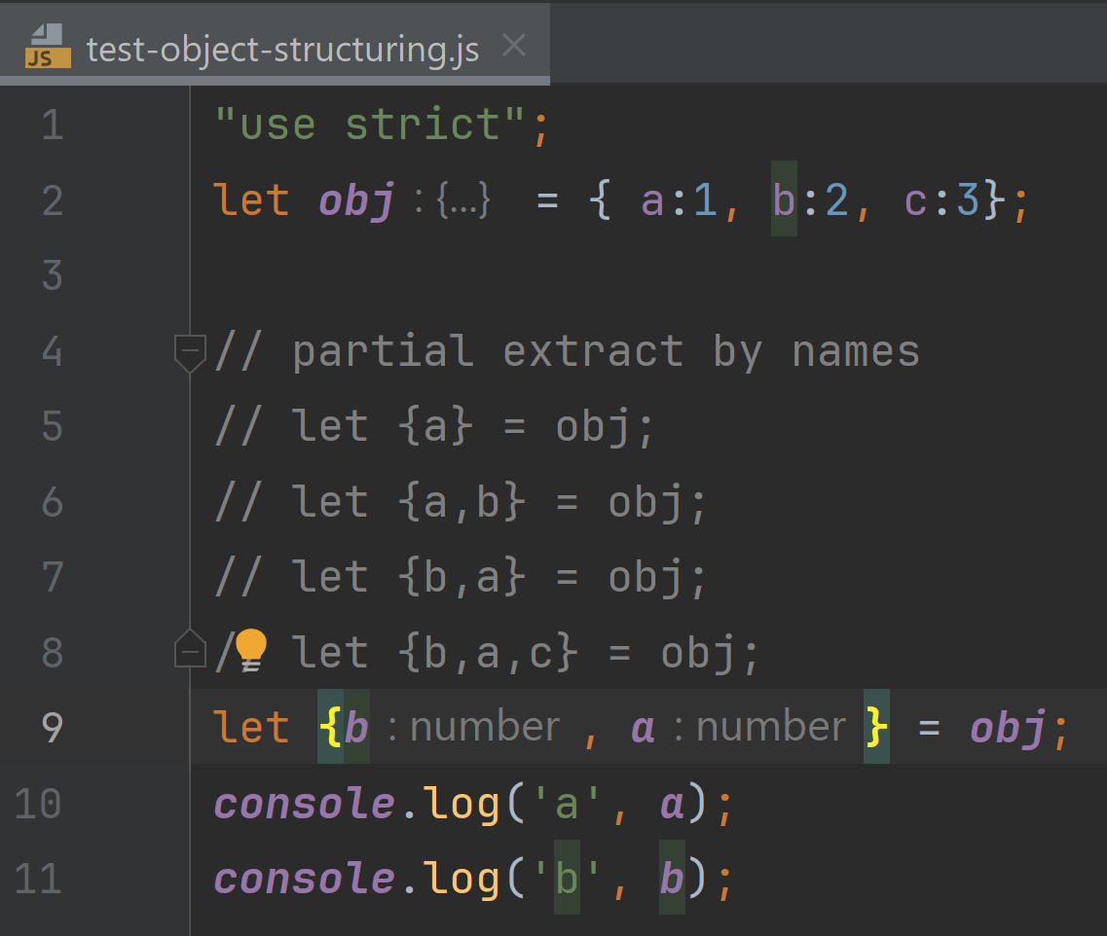
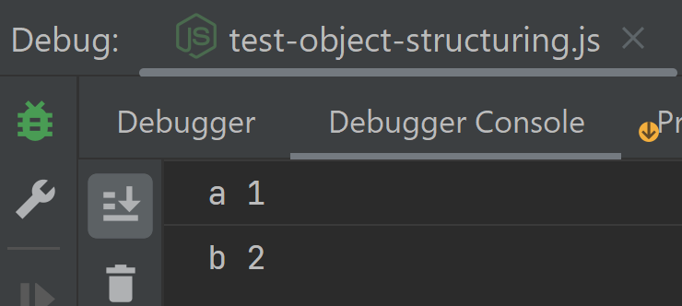
Object De-Structuring to variables

Slide 21
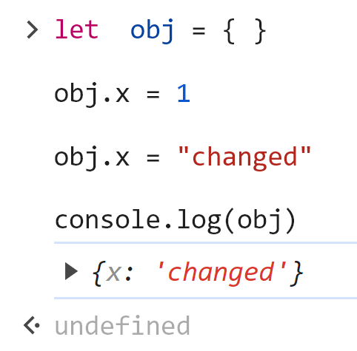
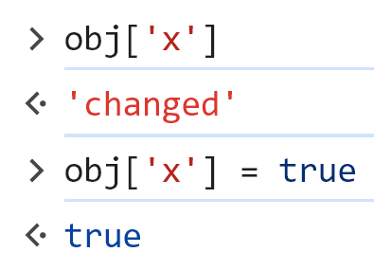
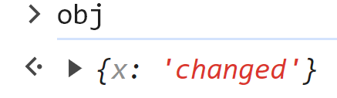
Objects (~= HashMap<String,*>)
using field Array notation :

Slide 22
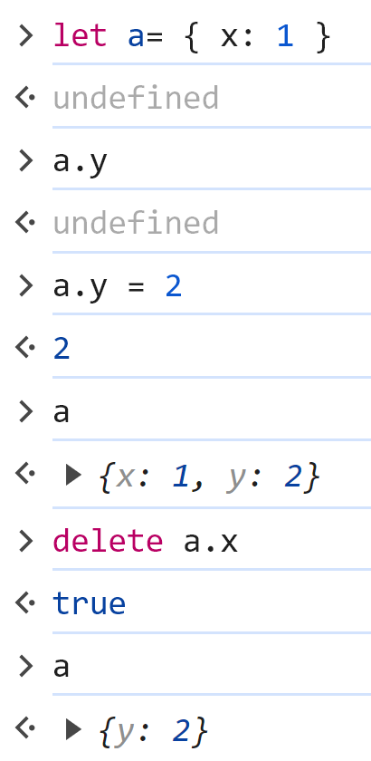
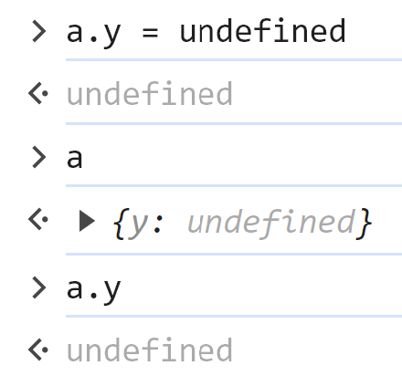
Undefined Field
get unknown field
=> NO error, return undefined
add new field on first set
set field undefined
delete field

Slide 23
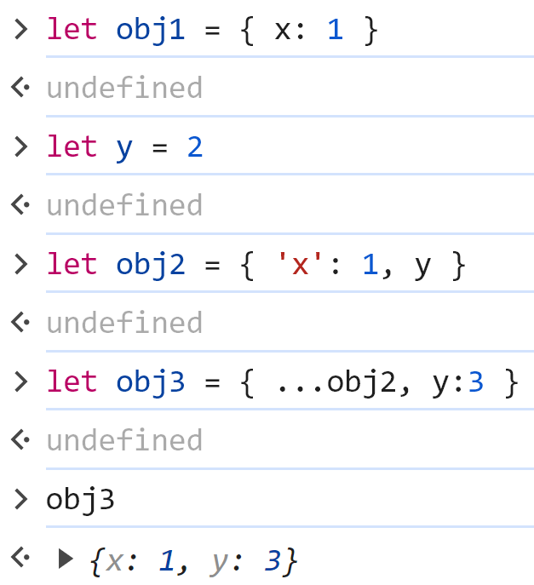
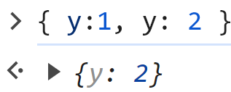
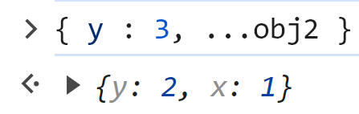
Syntaxic Sugar for Object Creations
can ommit quotes, double-quotes,
and even variable name as in 'y': y
object spreading operator
(last value override previous)

Slide 24
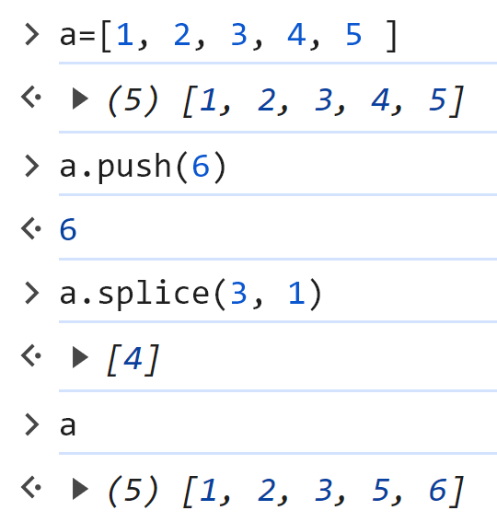
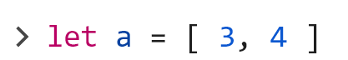
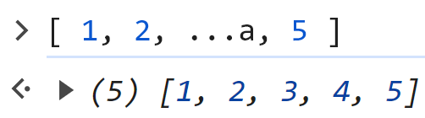
Array
spreading operator

Slide 25
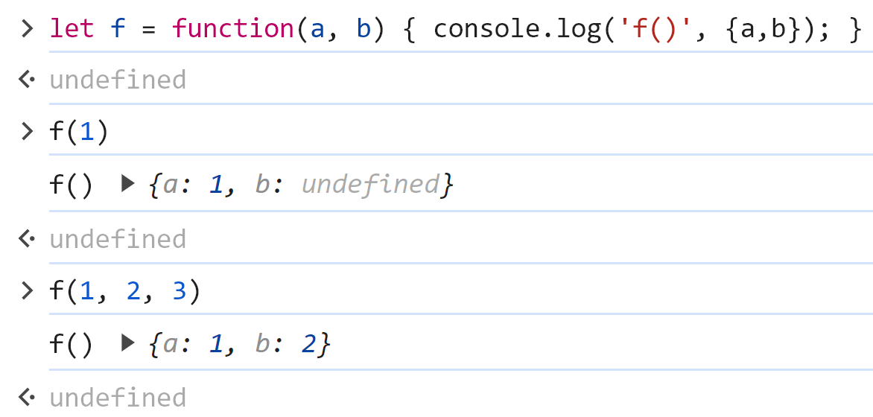
Functions

Slide 26
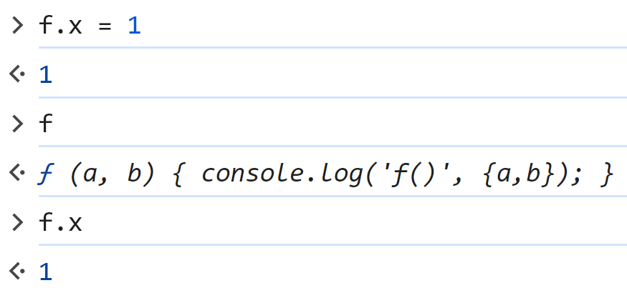
Functions are Object

Slide 27
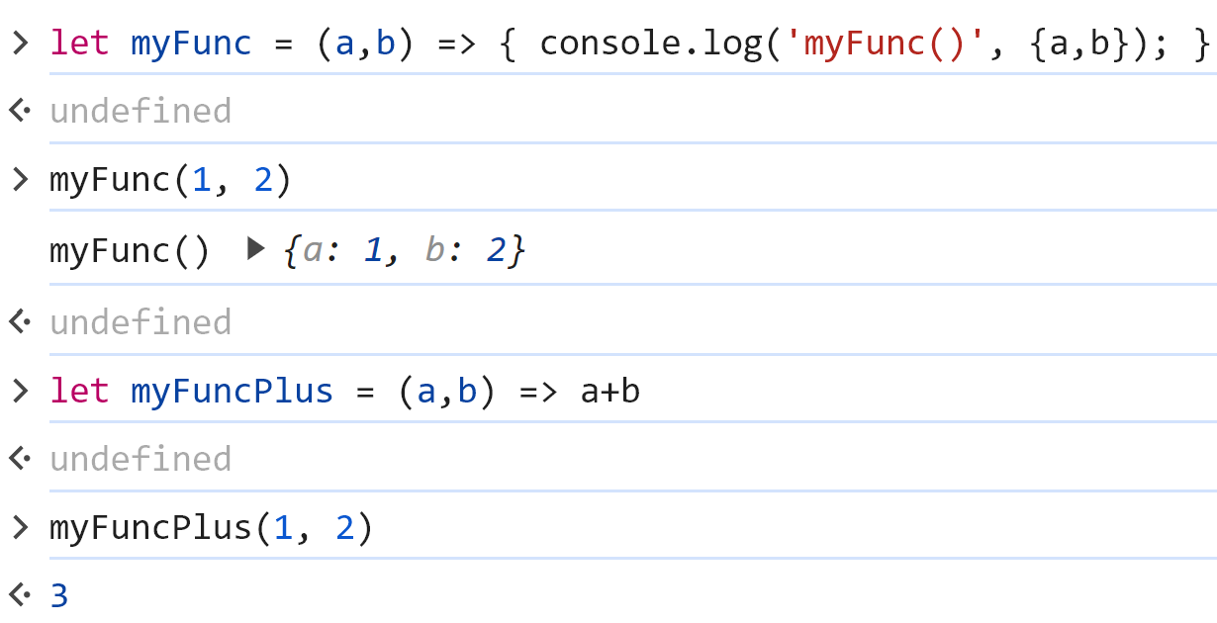
Arrow (Lambda) Function
arrow function with code block
arrow function with expression

Slide 28
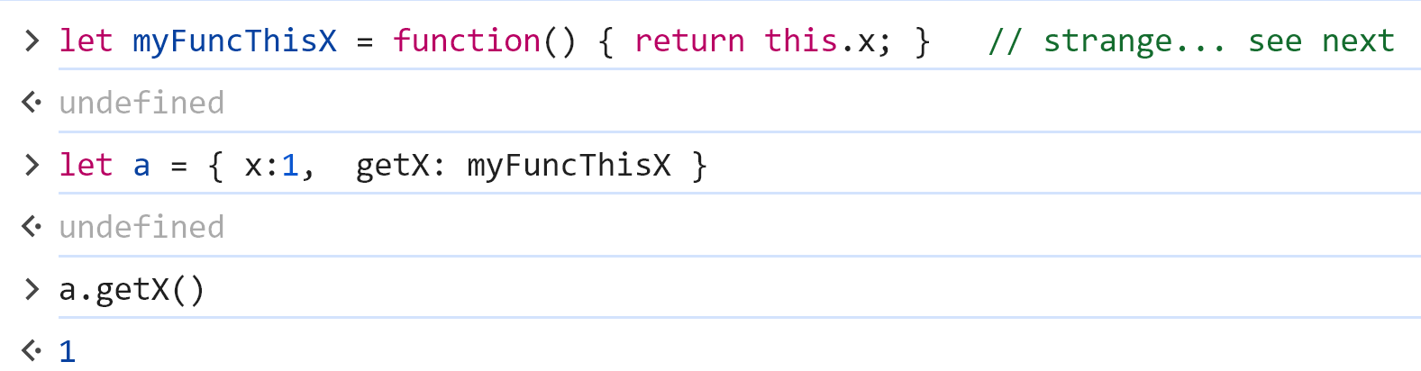
Function used as field ~ method ? this = ??

Slide 29
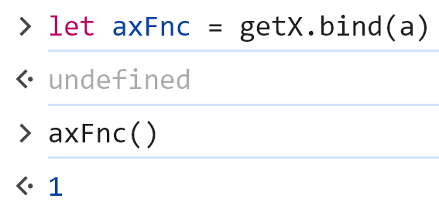
"this" bounded to function

Slide 30
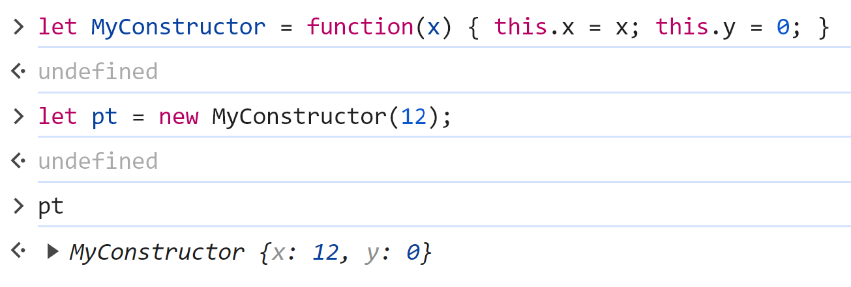
Function as "Class" Constructor

Slide 31
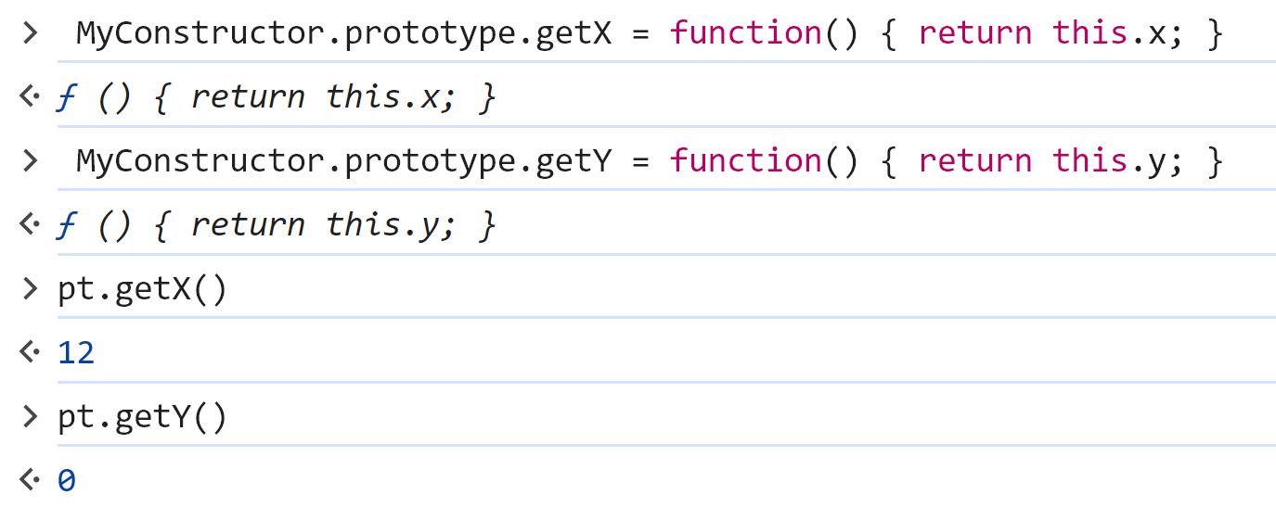
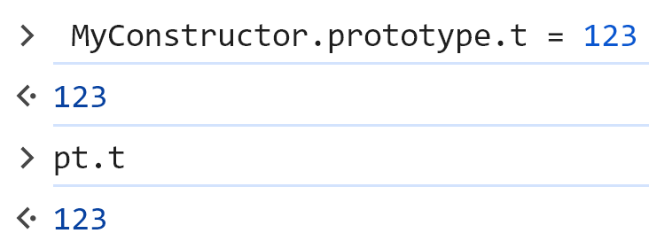
prototype
adding field (property / method) to object prototype => adding to all impacted instances

Slide 32
emulated class with Prototype (before EcmaScript2015)
using Typescript (transpiler to JavaScript)
class are emulated with prototype before EcmaScript2015
looks like class after ( but internally, still mutable prototype obects )

Slide 33
Type checking ? at "Compile Time" ??
add optional " : <typeDeclaration>" to variables
TypeScript = superset of JavaScript langage
a JavaScript file is a TypeScript file
(valid grammar, but maybe invalid type check)

Slide 34
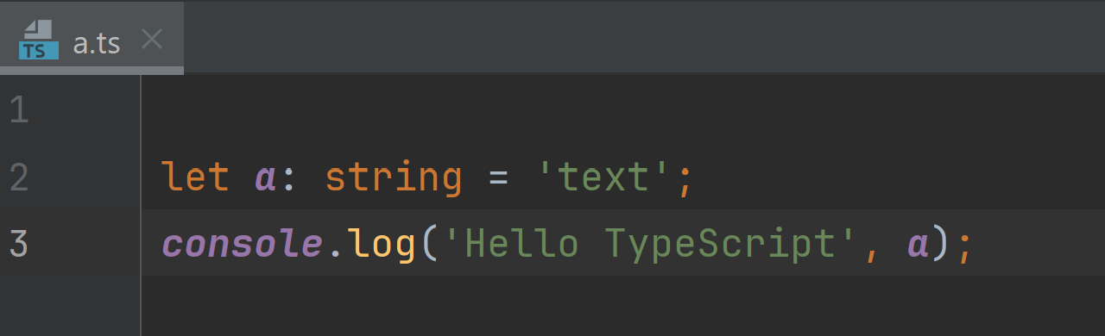
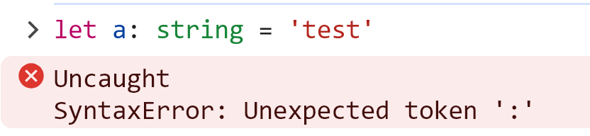
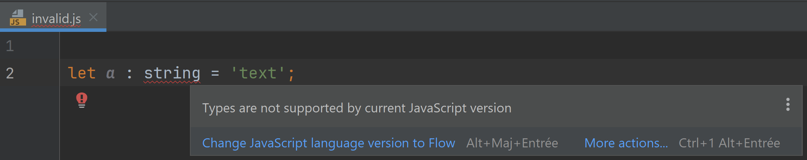
Edit Js to add ": <type>" to variables Rename file ".js" to ".ts" TypeScript
": <type>" is not valid JavaScript
valid in TypeScript

Slide 35
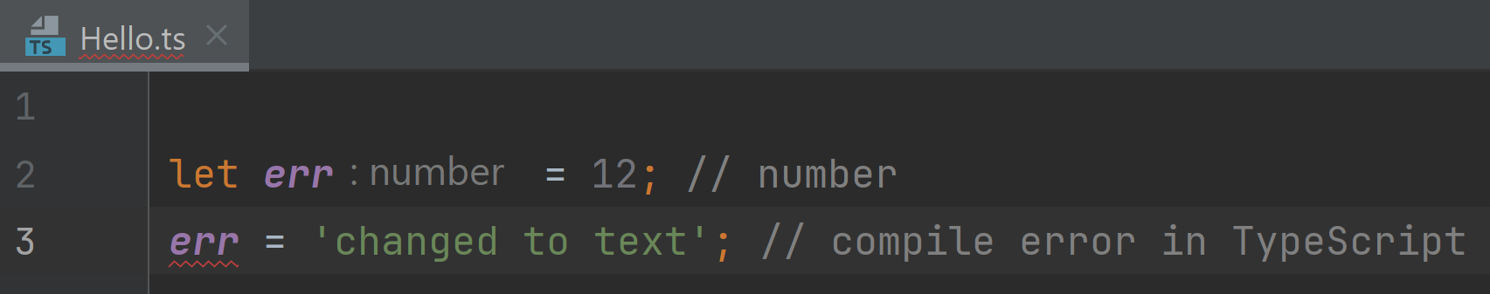
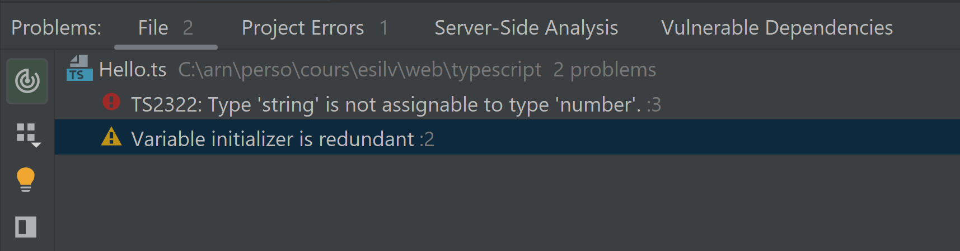
Compile Time checking ...
valid in untyped JavaScript
but not in TypeScript

Slide 36
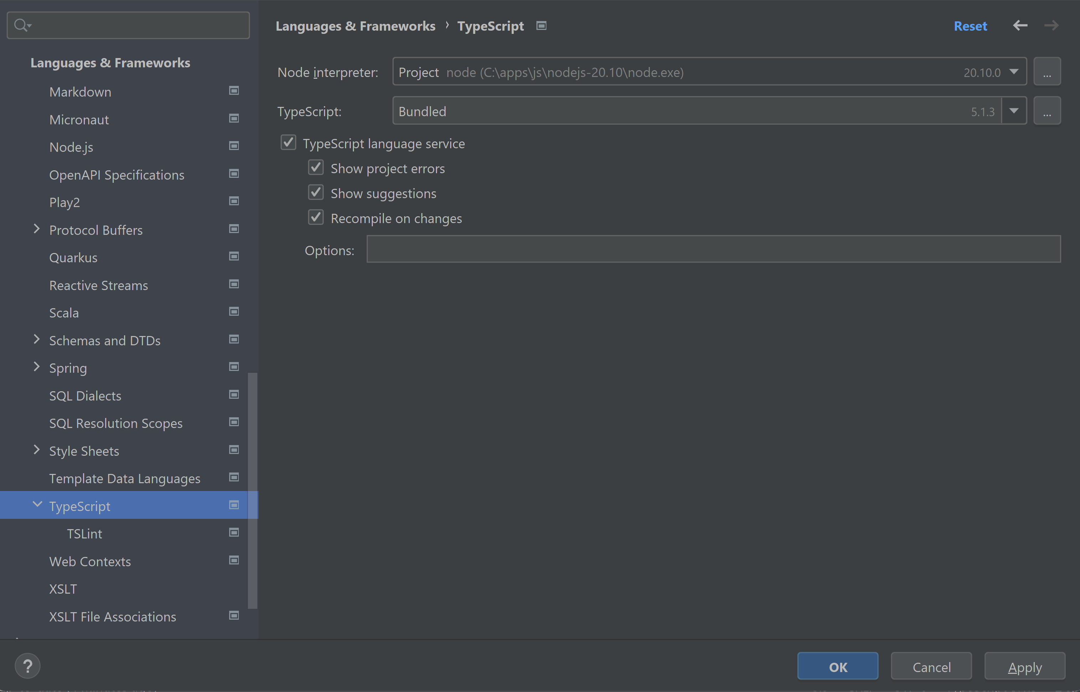
IntelliJ TypeScript : Recompile on changes

Slide 37
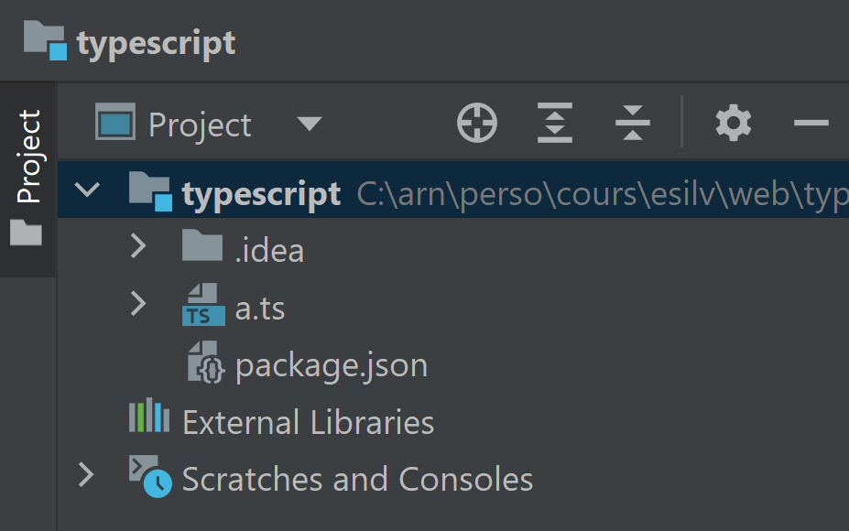
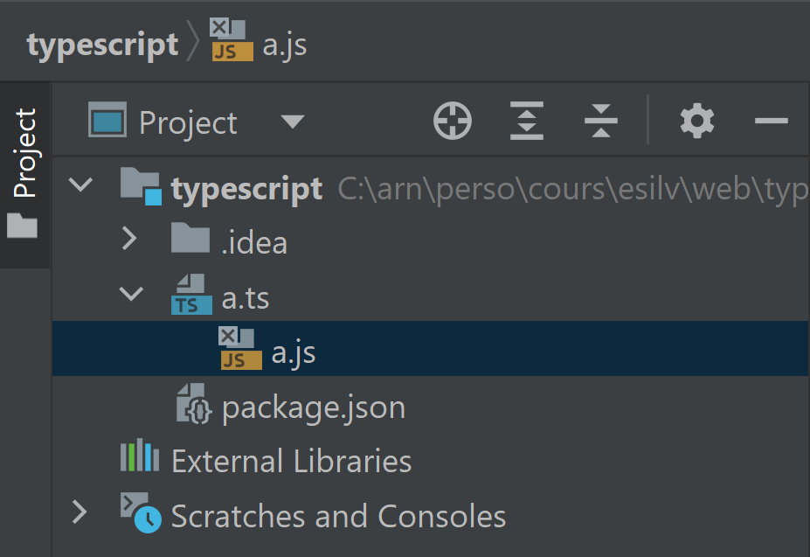
Js file generated from Ts file
expand to see
generated file

Slide 38
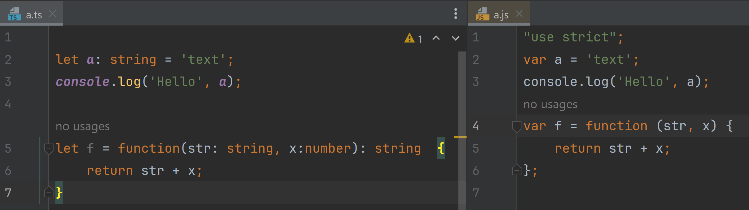
Transpile TypeScript = generate JS by mostly removing ": <typeDeclaration>"

Slide 39
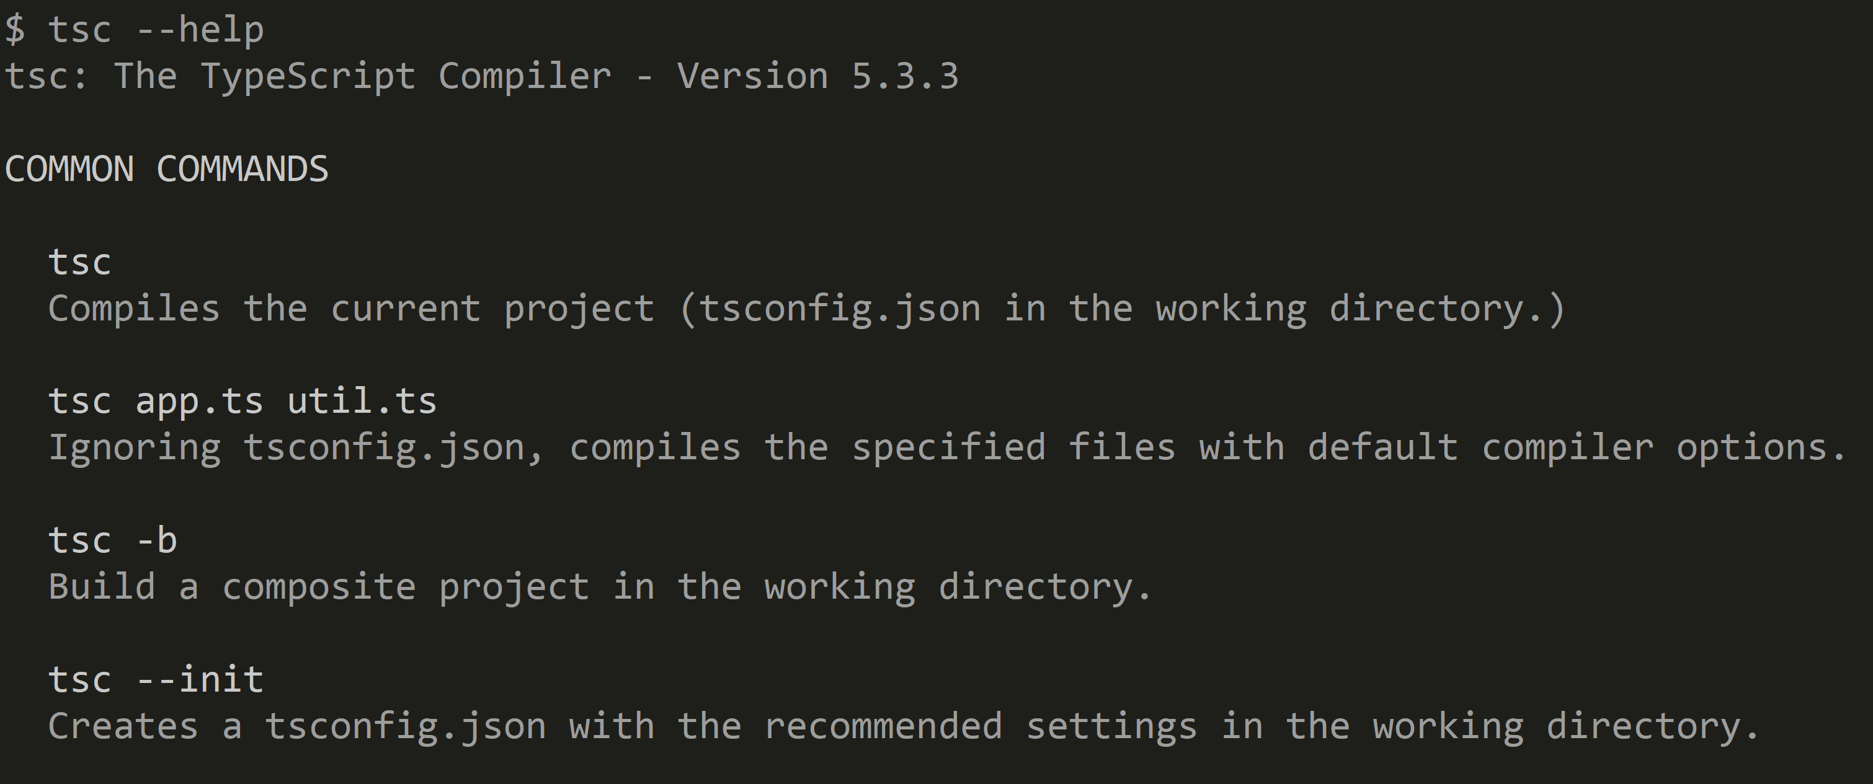
Tsc (=TypeScript Compiler)

Slide 40
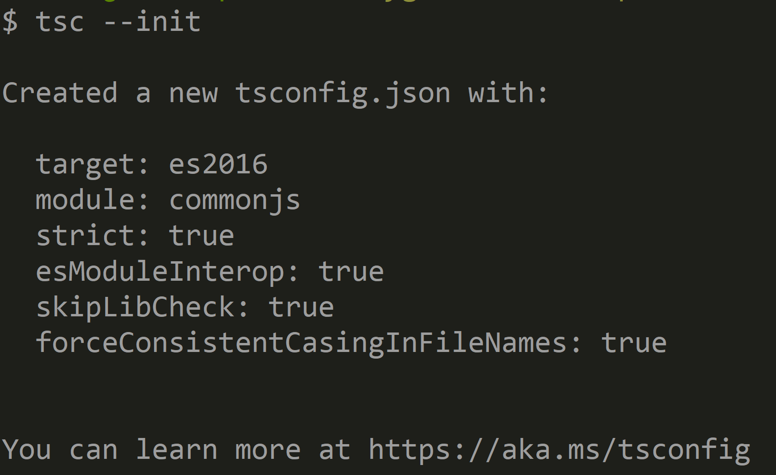
tsc --init

Slide 41
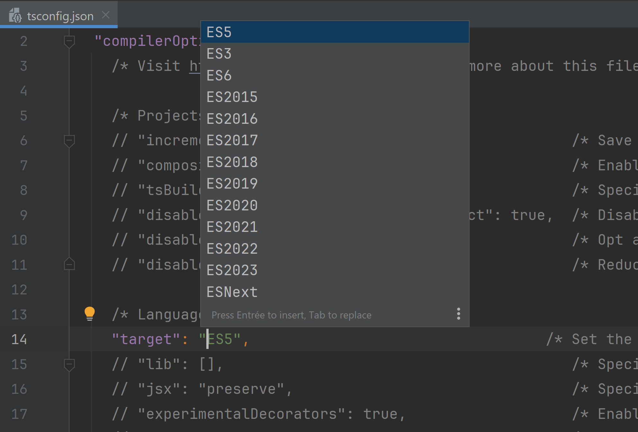
tsconfig.json using ES5 ... ES2023

Slide 42
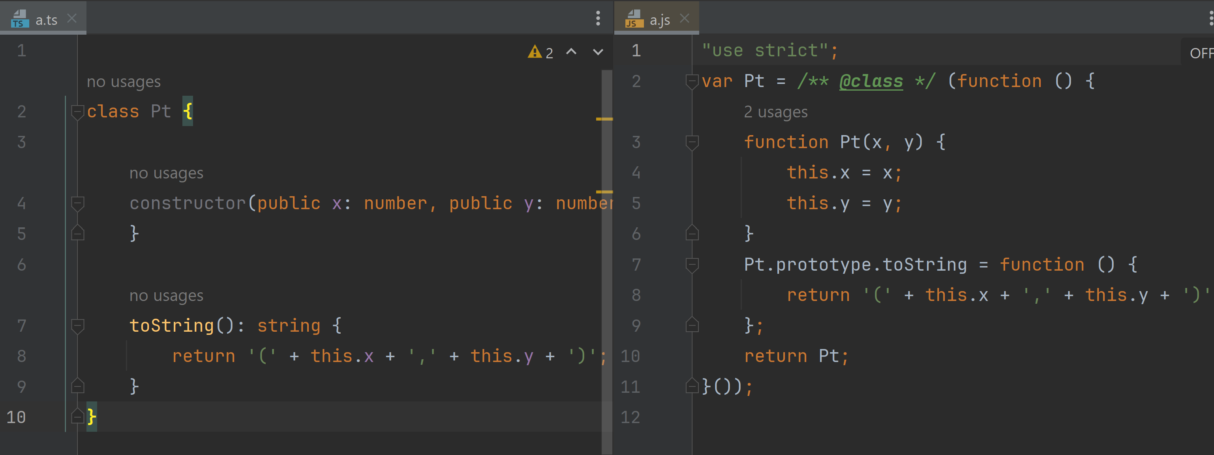
Example Emulating class with ES5

Slide 43
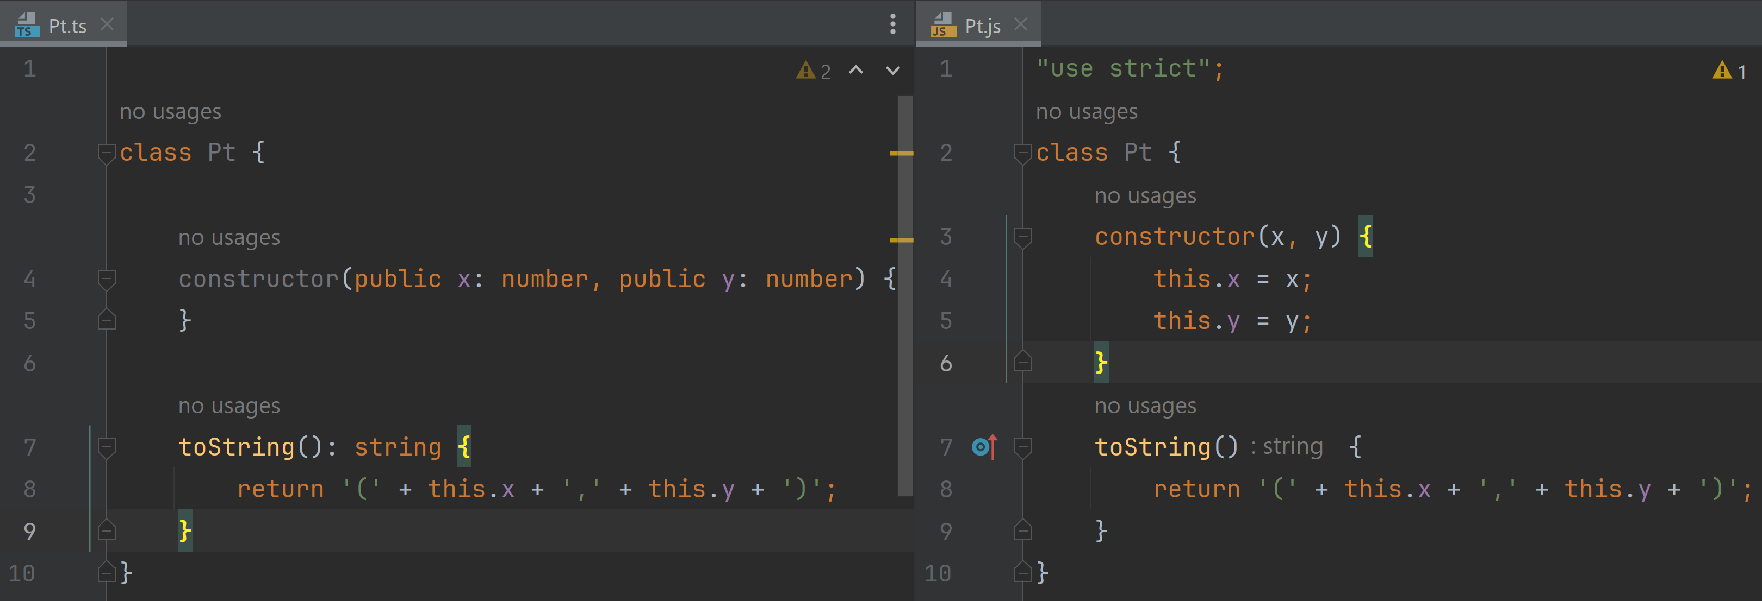
JavaScript evolve (from TypeScript ESNext) now have class since ES2015

Slide 44
JavaScript has weird "var" visibility

Slide 45
JavaScript has weird "var" visibility "use strict"; // at first line But still weird

Slide 46
JavaScript has weird "var" visibility "use strict"; // at first line use Immediatly Invoked Anonymous Function But still weird

Slide 47
JavaScript has weird "var" visibility "use strict"; // at first line use Immediatly Invoked Anonymous Function use "let" or "const" instead of "var" use TypeScript

Slide 48
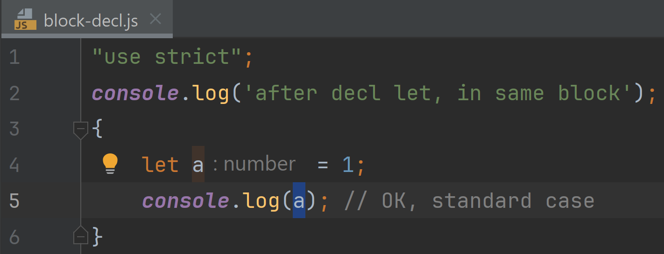
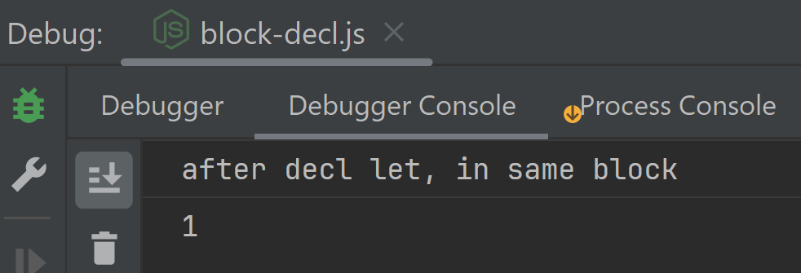
in "Standard Langages" 1/ declare, then 2/ init, then- 3/ use with scope = enclosing { block }

Slide 49
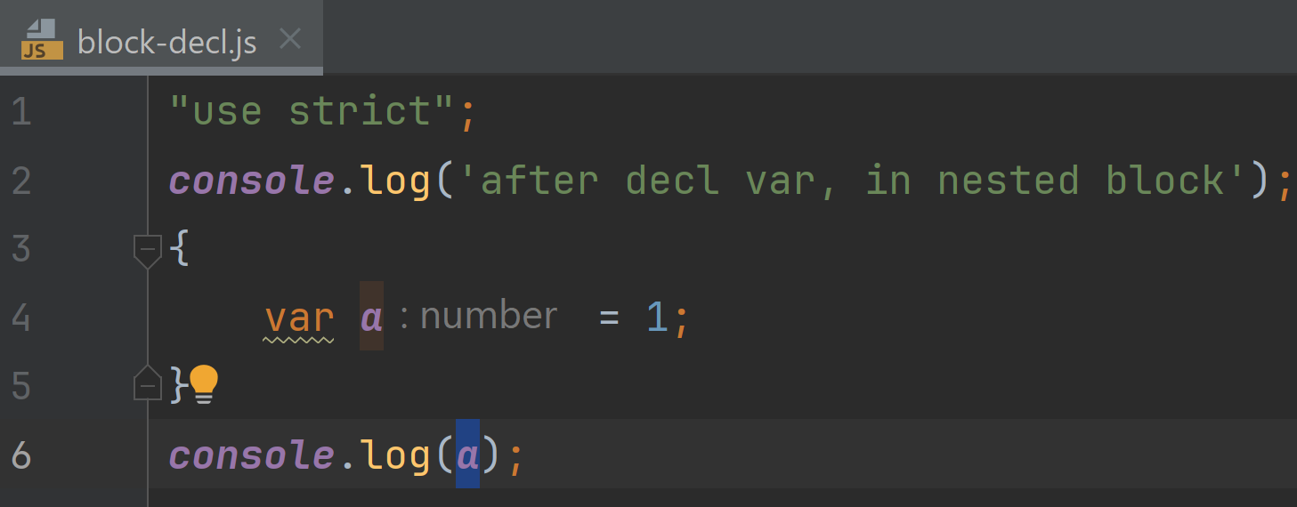
JavaScript has weird "var" visibility
What do you think ??
a/ does not "evaluate" / "run" / "compile"
b/ throws exception
c/ print "undefined"
d/ print "1"

Slide 50
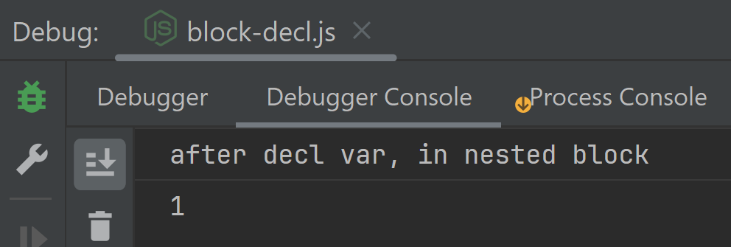
Answer: d/ print 1 the scope of visibility if the enclosing function ( not the enclosing block)

Slide 51
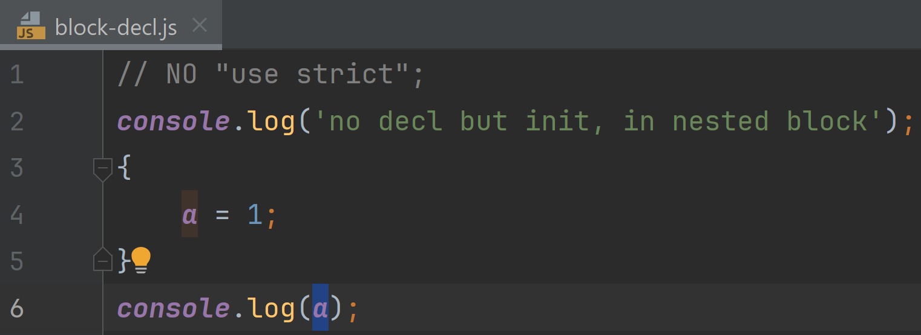
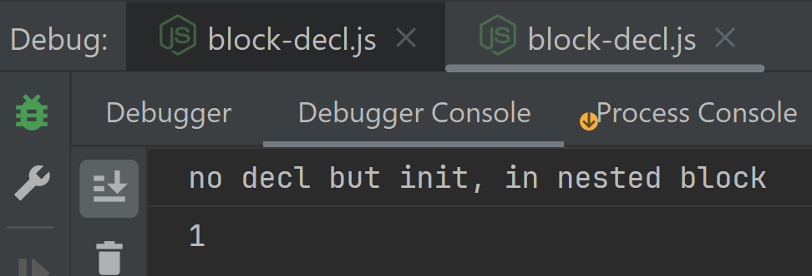
without "use strict" ... NO need to decl "var"

Slide 52
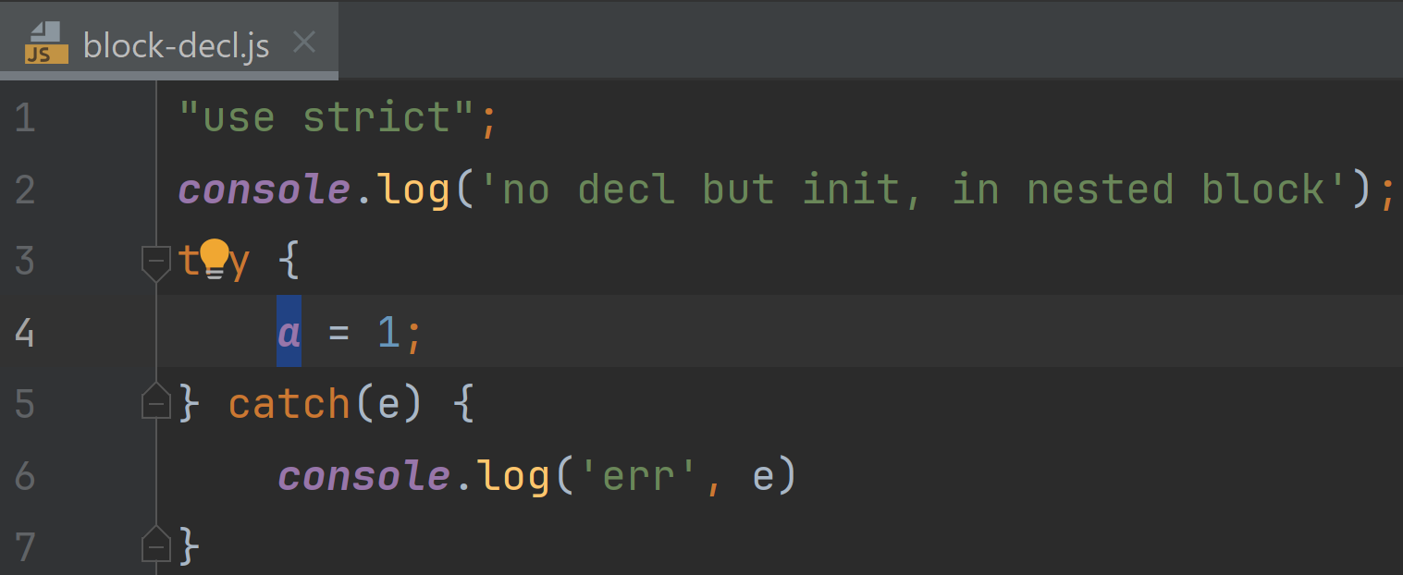

with "use strict";

Slide 53


even stranger: use before declare in nested block

Slide 54

other strange "var" visibility

Slide 55

JavaScript has weird "var" visibility
declared "ok"
BUT not initialized yet => undefined !

Slide 56


work around for scope : "Immediatly Invoked Anonymous Function"

Slide 57




"let" | "const" ... as "var" replacement

Slide 58


"let" ( or "const") in same block

Slide 59


not init (ok in JS !) but does not compile in TypeScript

Slide 60
100 reasons you need TypeScript and will probably love it
everybody hate JavaScript, for million reasons

Slide 61
Spoiler Alert TypeScript is NOT "more efficient" than JS ... it is just typed-checked at Compile-Time then translated to JS at Runtime, you still have poor old Node.js or Web Browser

Slide 62
TypeScript Types
Primitive Types (for values) : any, null, undefined, boolean, number, string
Composite Types:
" | " Union (choice between types)
" & " combination of type constraint
"readonly" type modifier
Array
Interfaces : type constraint on existence of field / partial field in Object
" ? " Optional Field Type (for accepting "undefined")
Function, Class, Templates, etc.

Slide 63

any ?
any ... as name implies
= No Type checking !
To use TEMPORARILY while porting JS to Ts
Good Ts program(er)s should never use "any"

Slide 64

Union Type

Slide 65
Example usages Type | null Type |undefined

Slide 66

Force type-check with "!!"

Slide 67

Duck Typing

Slide 68

Structural Interface Typing, Combine Partial
= type inferred (displayed by IntelliJ), NOT edited in file

Slide 69

Type Checking "missing property" in Interface

